Slide 1

DevOps Unit 2 :
Version Control-GIT

Slide 2
Contents
GIT Features
3-Tree Architecture
GIT – Clone /Commit / Push
GIT Hub Projects
GIT Hub Management
GIT Rebase & Merge
GIT Stash, Reset, Checkout
GIT Clone, Fetch, Pull

Slide 3
Introduction to Git
Git is a free, open-source distributed version control system. It keeps track of projects and files as they change over time with the help of different contributors.
Version control is a system that records changes to a file, or set of files, over time so that you can recall specific versions later.
Git helps keep track of changes made to a code. If at any point during coding you hit a fatal error and don’t know what’s causing it, Git allows you to revert back to a stable state.
It also helps you see what changes have been made to the code over time.

Slide 4
Why do we need Version Control System?
When multiple team members work on the same project, it is essential to have version control for the program. Version control system helps the team to share changes and merge changes made to artifacts seamless and efficient. In DevOps, other than keeping track of changes, VCS also helps in developing and shipping the products faster. VCS improves the following factors: Collaboration
Storing Versions
Backup
Improves visibility
Accelerate product delivery

Slide 5
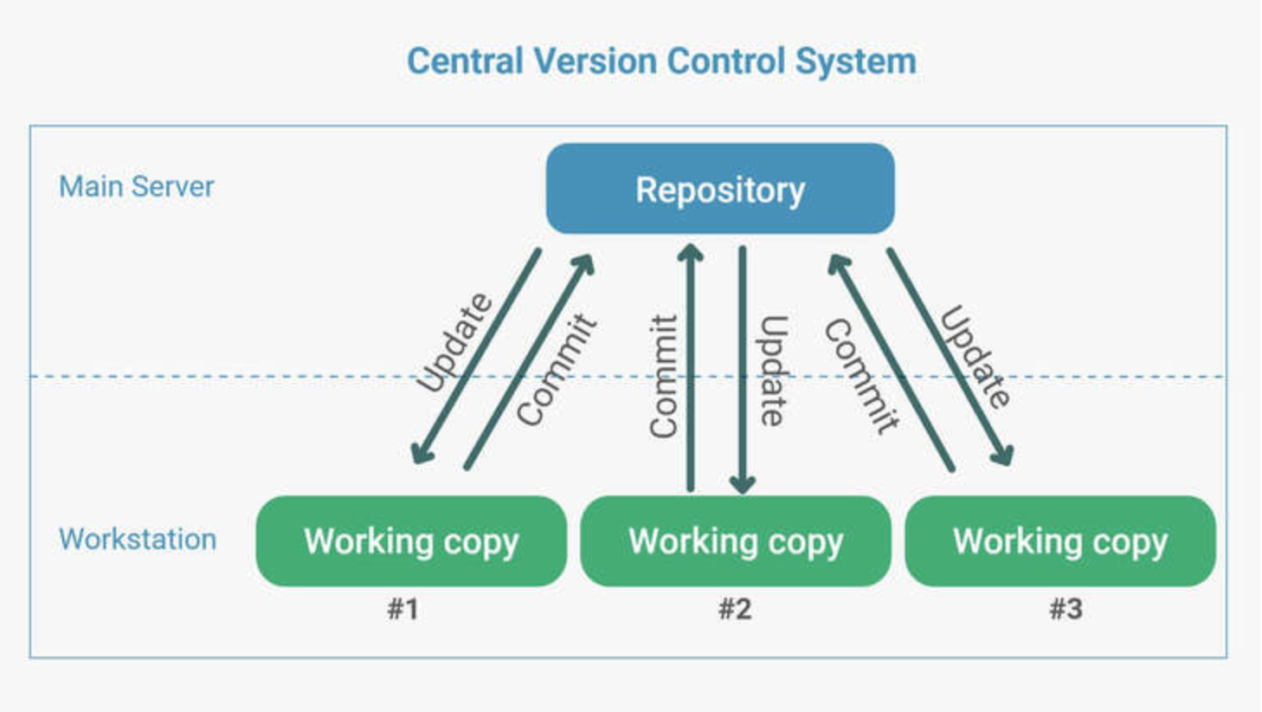
Central Version Control System (CVCS)

Slide 6
In CVCS, the central server stores all the data. This central server enables team collaboration. It just contains a single repository, and each user gets their working copy. We need to commit, so the changes get reflected in the repository. Others can check our changes by updating their local copy.

Slide 7
Drawbacks of CVCS It is not locally available, which means we must connect to the network to perform operations.
During the operations, if the central server gets crashed, there is a high chance of losing the data.
For every command, CVCS connects the central server which impacts speed of operation.
The Distributed Version Control System is developed to overcome all these issues.

Slide 8
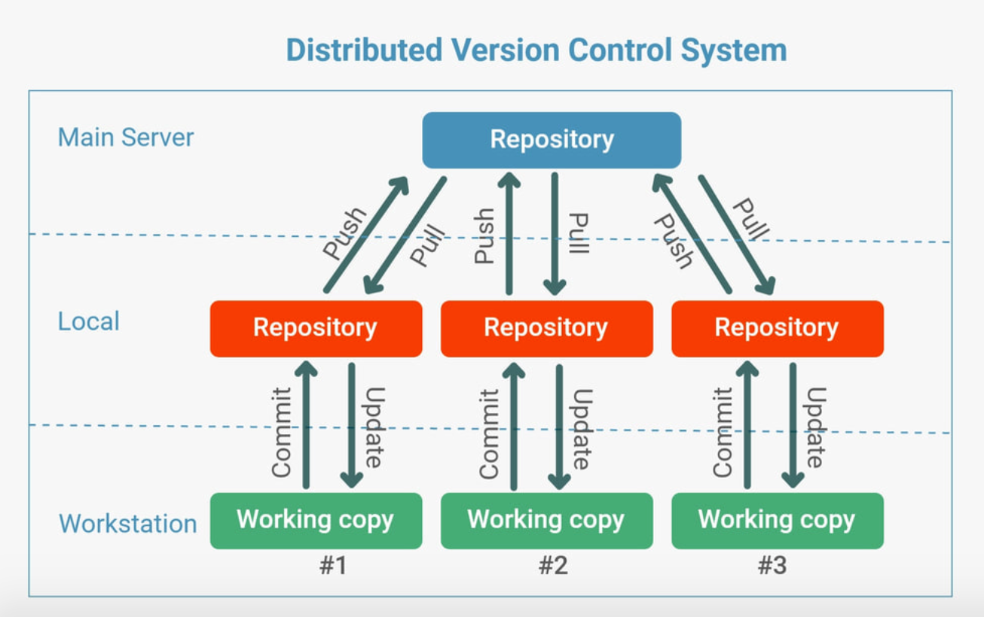
Distributed Version Control System (DVCS)

Slide 9
In DVCS, there is no need to store the entire data on our local repository. Instead, we can have a clone of the remote repository to the local. We can also have a full snapshot of the project history.
The User needs to update for the changes to be reflected in the local repository. Then the user can push the changes to the central repository.
If other users want to check the changes, they will pull the updated central repository to their local repository, and then they update in their local copy.

Slide 10
Except for pushing and pulling the code, the user can work offline in DVCS
DVCS is fast compared to CVCS because you don't have to contact the central server for every command
Merging and branching the changes in DVCS is very easy
Performance of DVCS is better
Even if the main server crashes, code will be stored in the local systems

Slide 11
Architecture of GIT
A distributed system is one that allows collaborators to access the central repository using a VCS, even from the remotest corner of the world.
As Git maintains a snapshot every time a user pulls a file, the risk of data loss due to system failure or lack of Internet connection is mitigated.
Users are allowed to work on the same bit of code simultaneously without getting interfered by others.

Slide 12
The three layers are:
Working directory: This is created when a Git project is initialized onto your local machine and allows you to edit the source code copied.
Staging area: Post the edits, the code is staged in the staging area by applying the command, git add. This displays a preview for the next stage. In case further modifications are made in the working directory, the snapshots for these two layers will be different. However, these can be synced by using the same ‘git add’ command.
Local repository: If no further edits are required to be done, then you can go ahead and apply the git commit command. This replicates the latest snapshots in all three stages, making them in sync with each other.

Slide 13
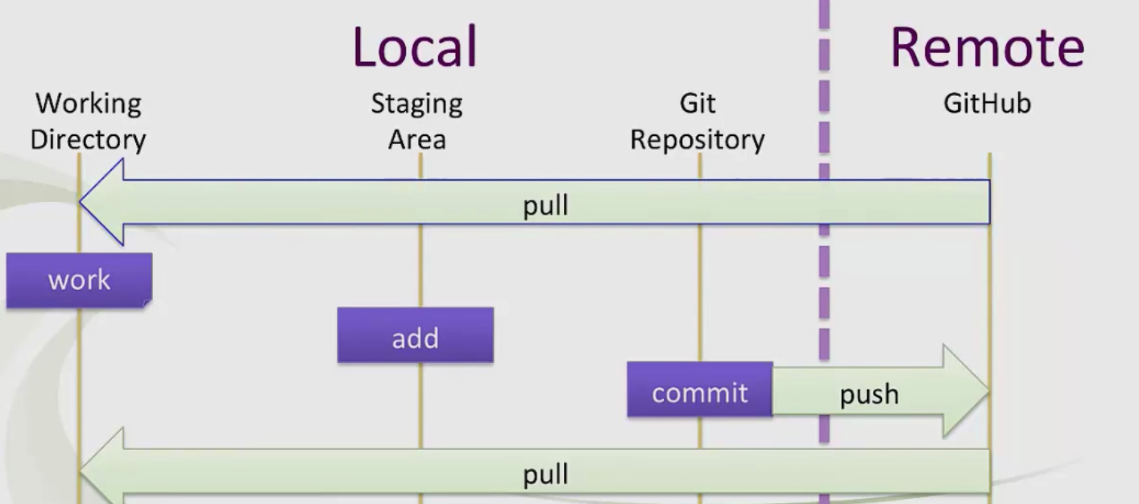

Slide 14
How to use Git and create GITHUB account
Sudo SU
Yum update
Yum install get –y
Get –version
Get config --global user name “ abc/ xyz”
Get config –global user email “abc@gmail.com”

Slide 15
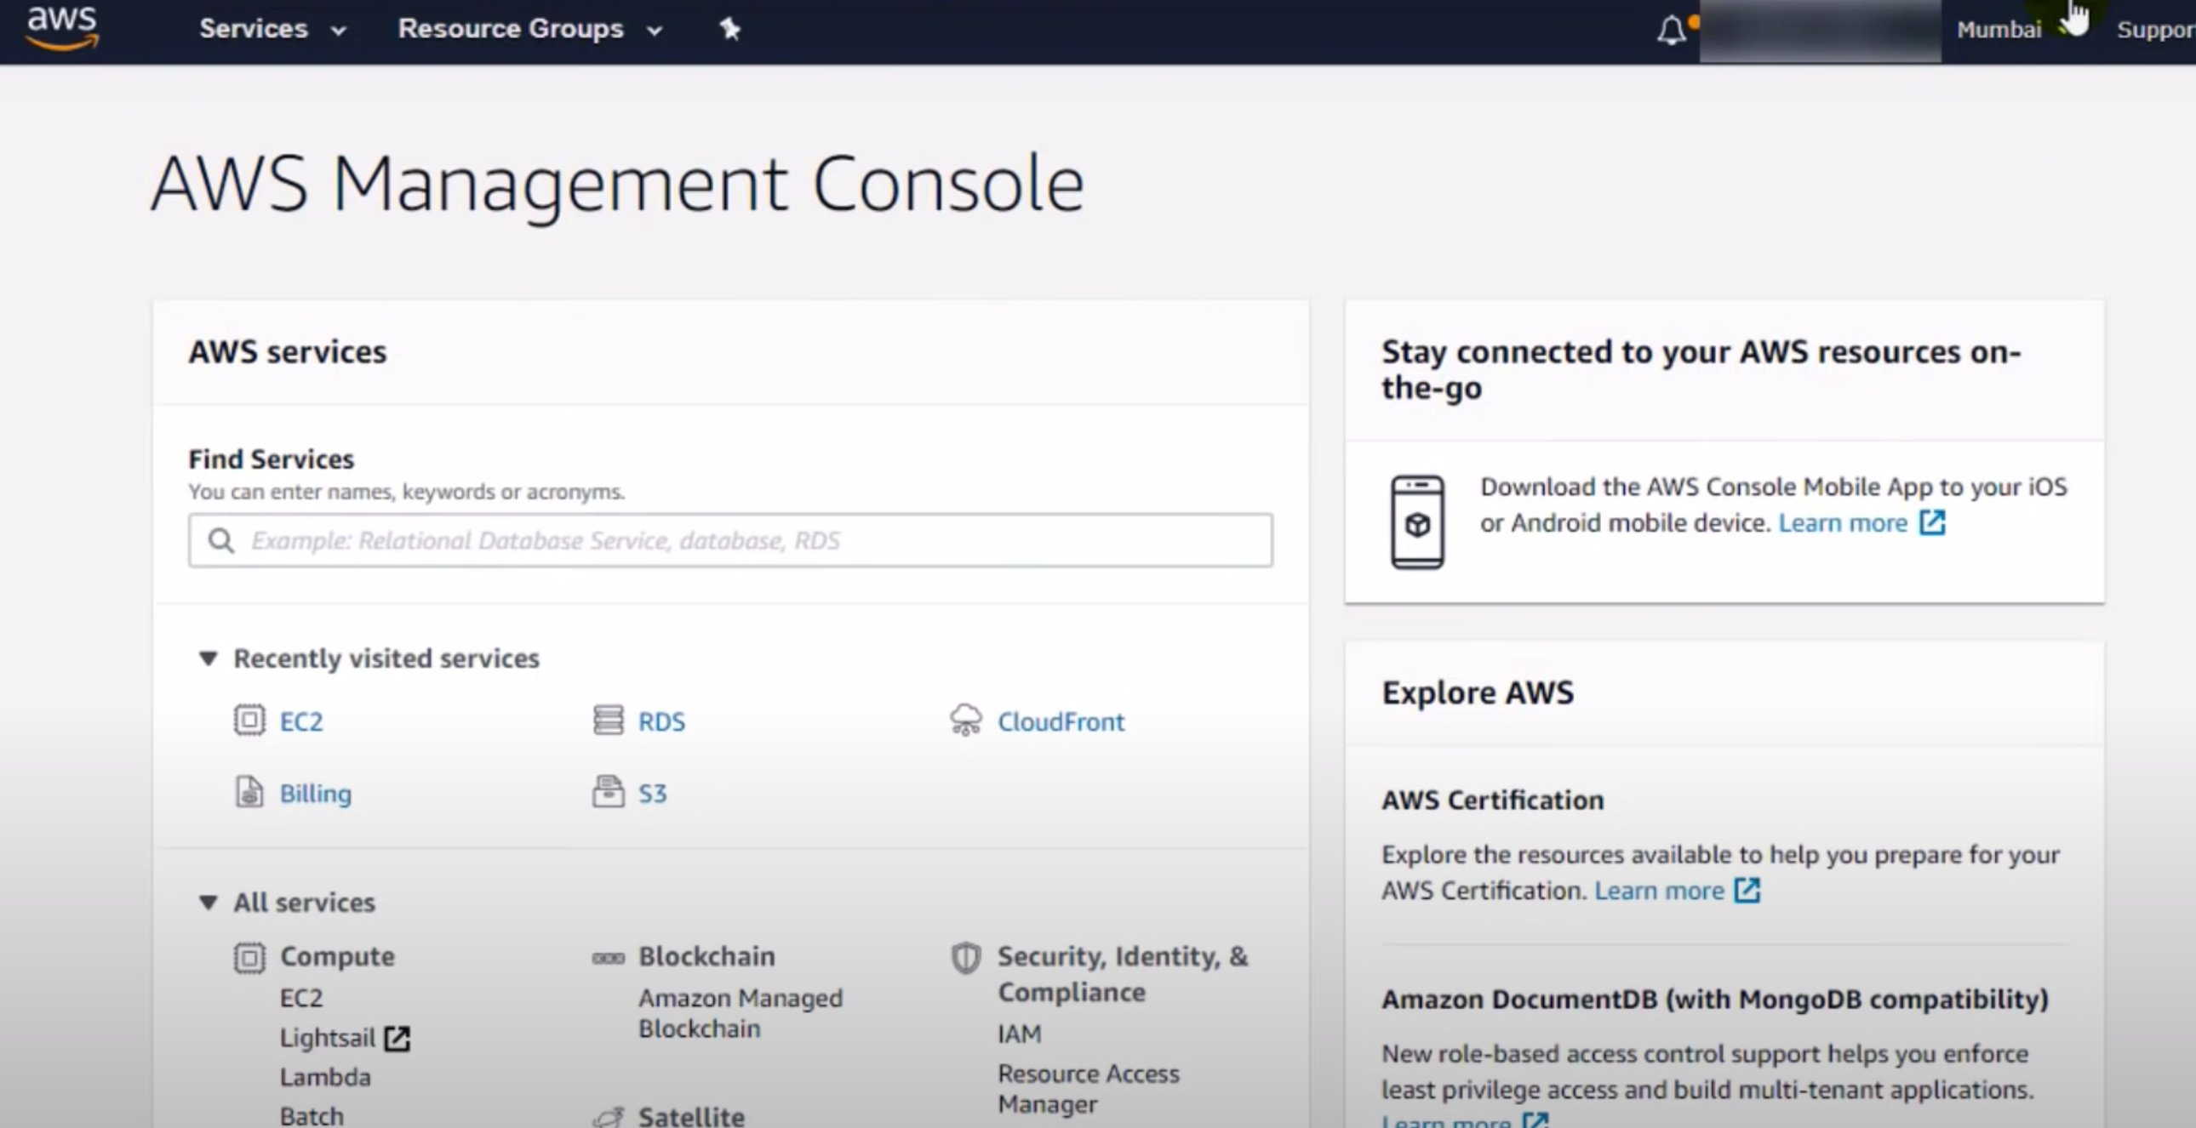

Slide 16
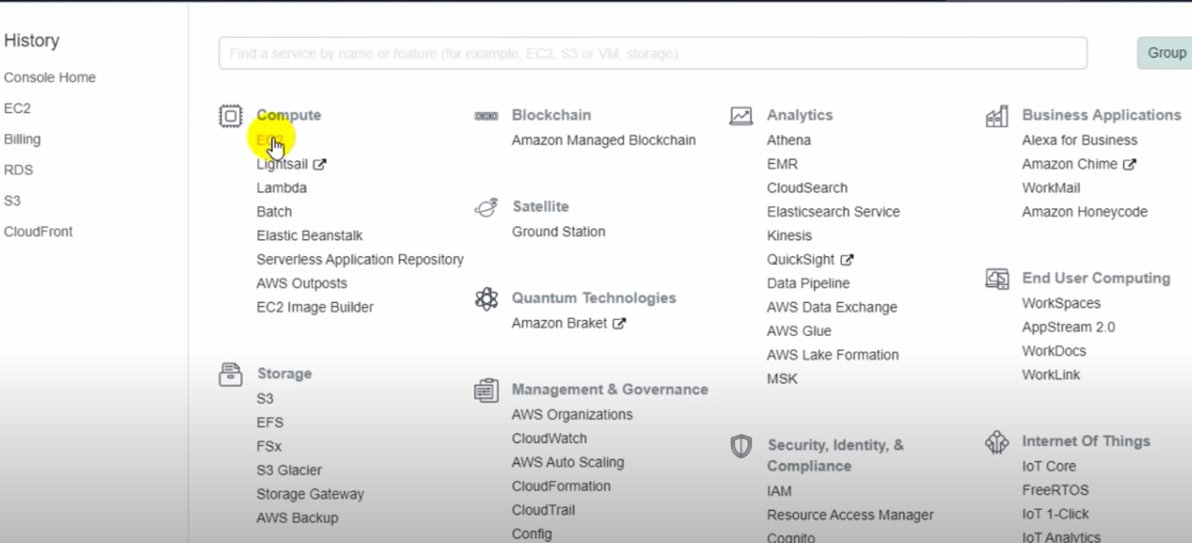

Slide 17
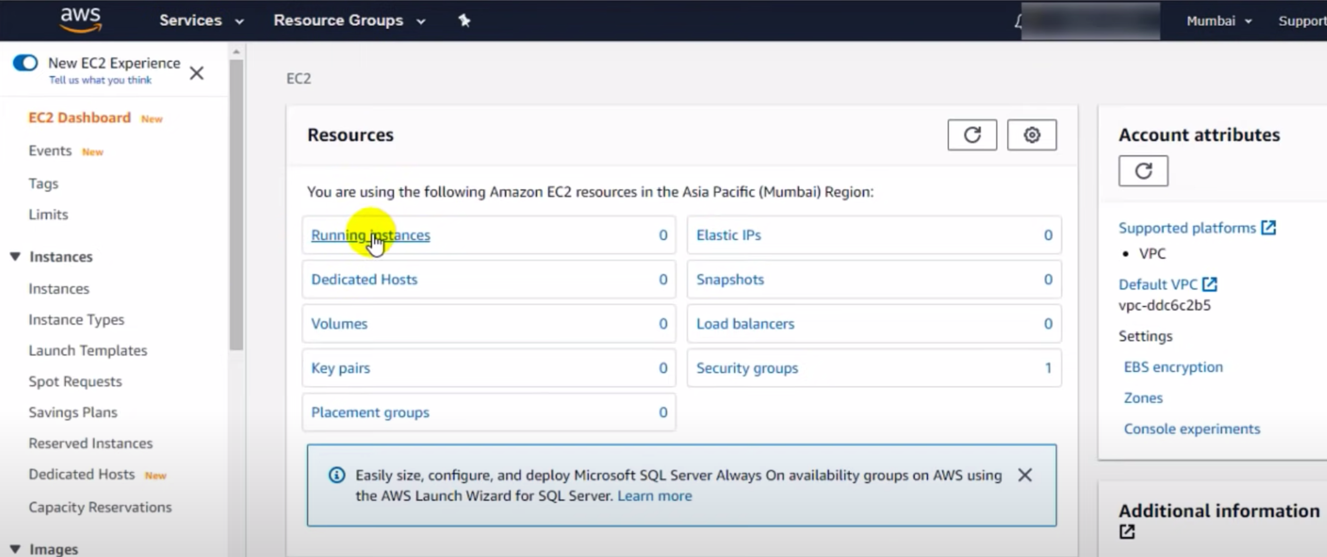

Slide 18
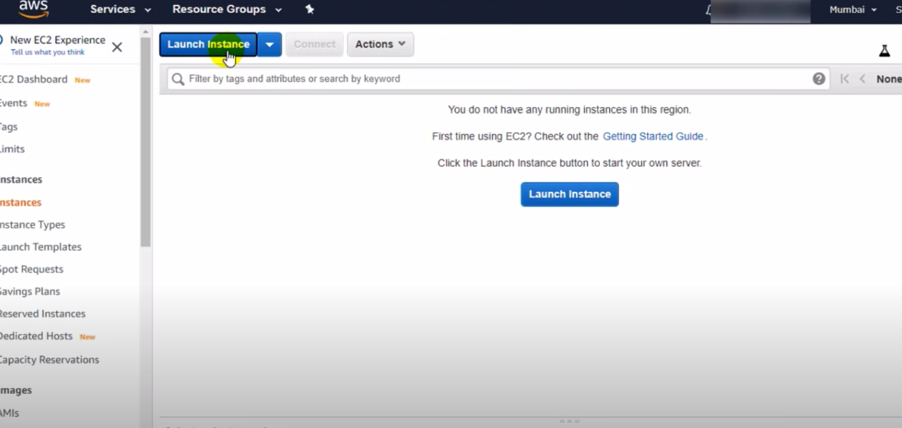

Slide 19
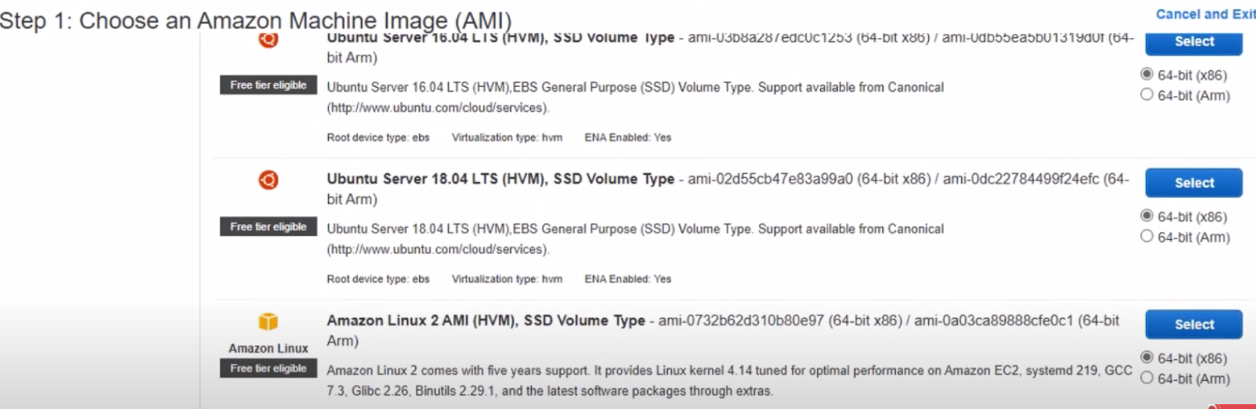

Slide 20
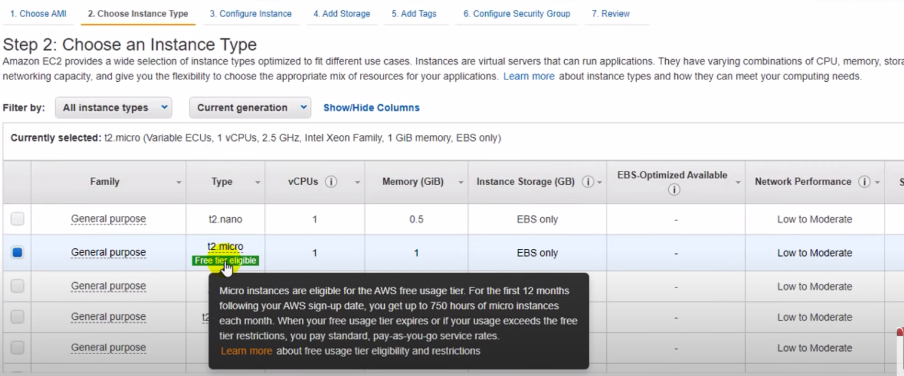

Slide 21
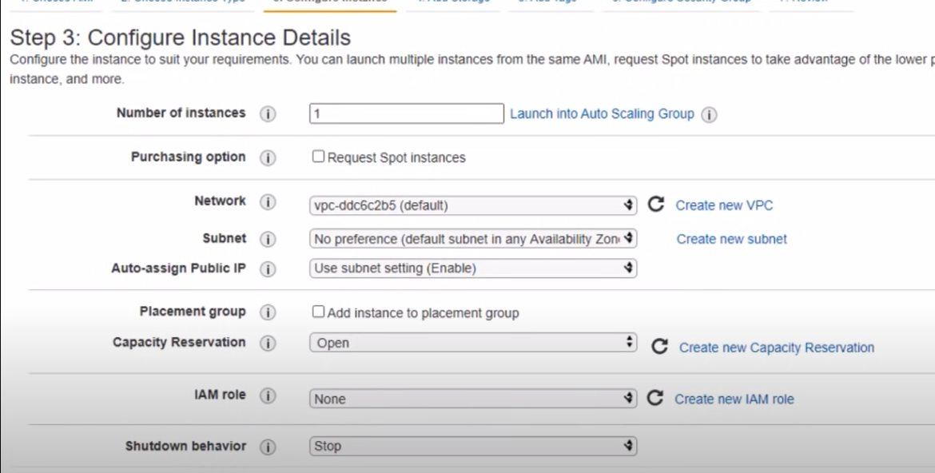

Slide 22
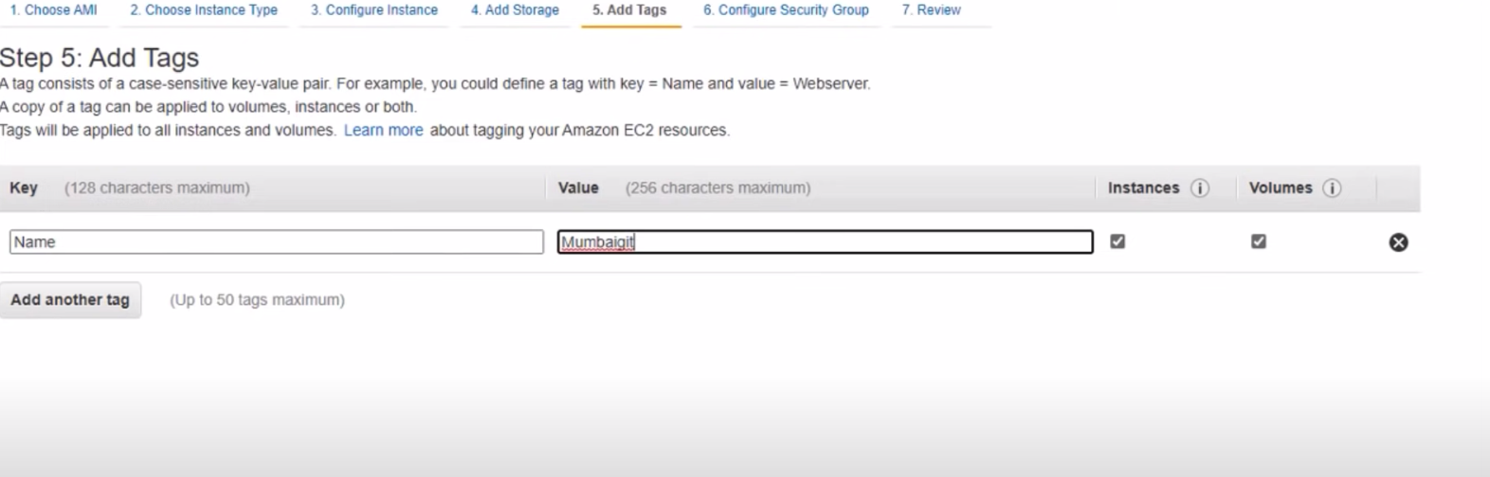

Slide 23
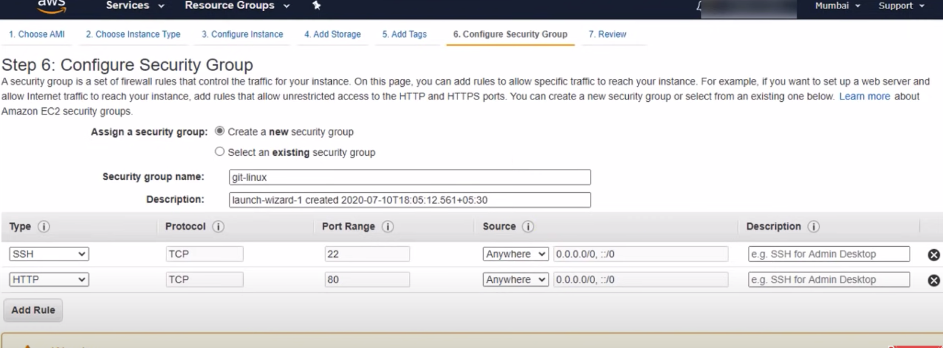

Slide 24
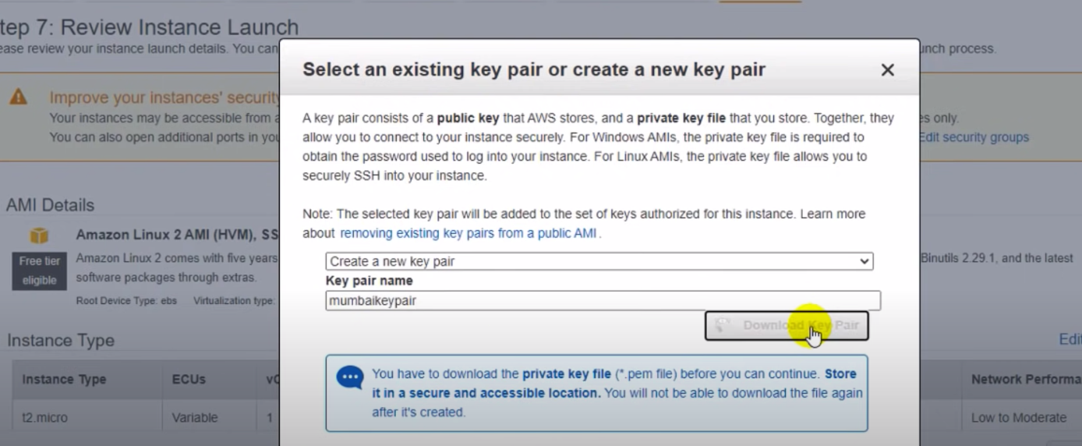

Slide 25
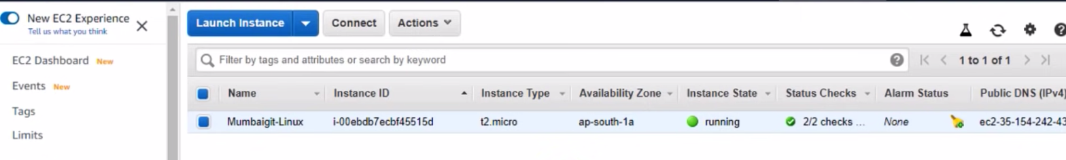

Slide 26
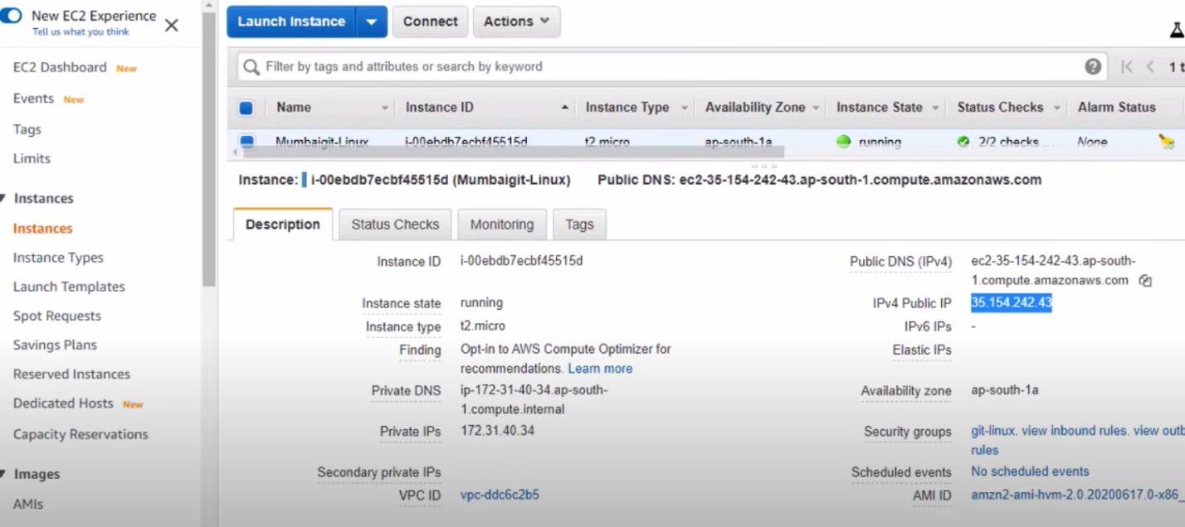

Slide 27
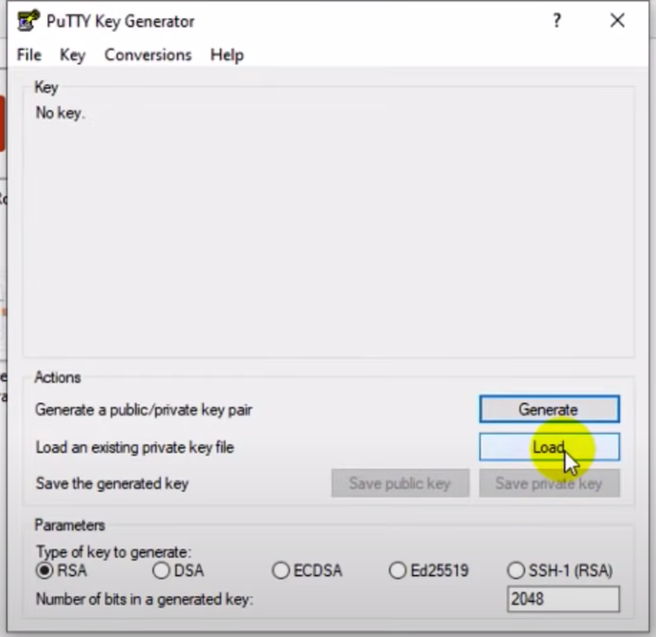
Open Putty Gen
Click on Load
When you will load open downloads for all fliles

Slide 28
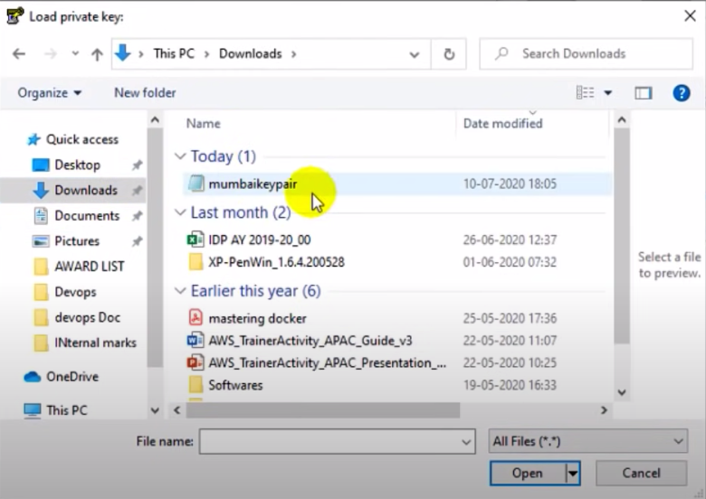

Slide 29
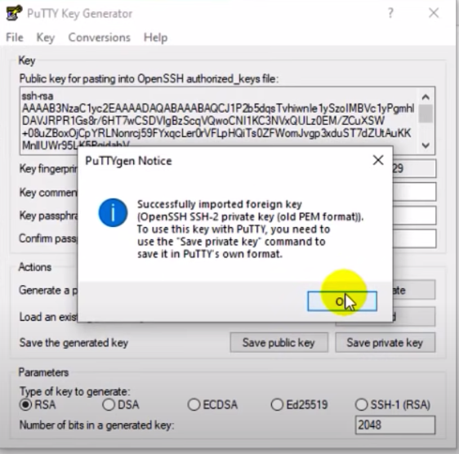
Open this key, save it by clicking on save private key.
Save it on deskstop by the name of mumbai1 and close it.

Slide 30
Open Putty software
Ad. Public IP
SSH→ Auth
openMumbai1 just downloaded

Slide 31
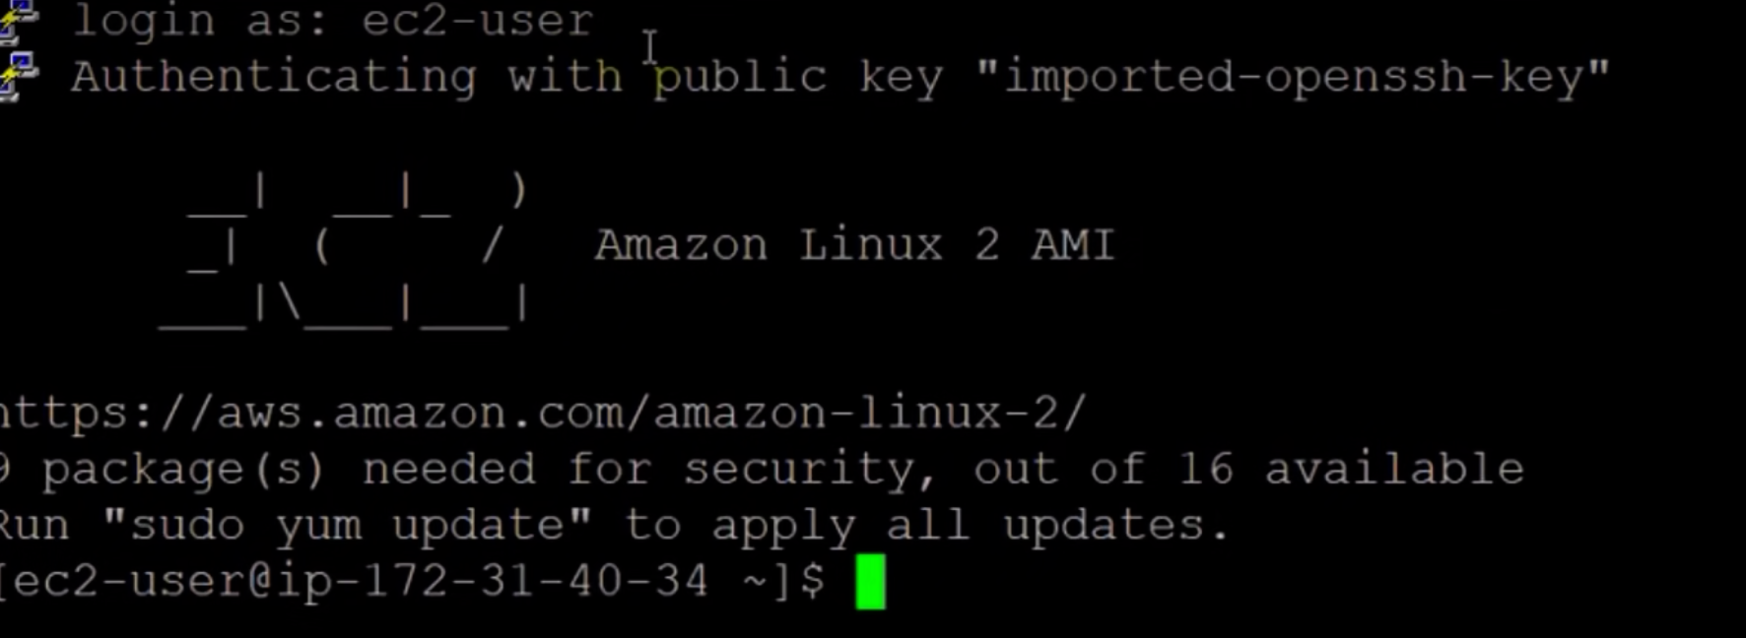
Login as EC2 Instances

Slide 32
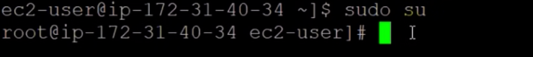
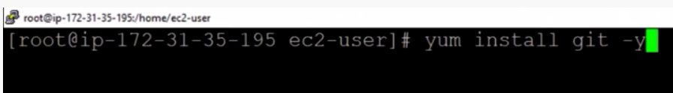
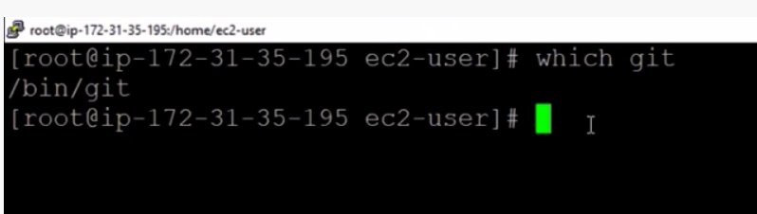
Become root user with sudo su
Yum update –y
Yum install git-y
This means its in directory named GIT

Slide 33
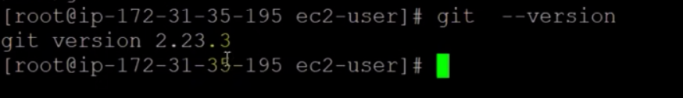
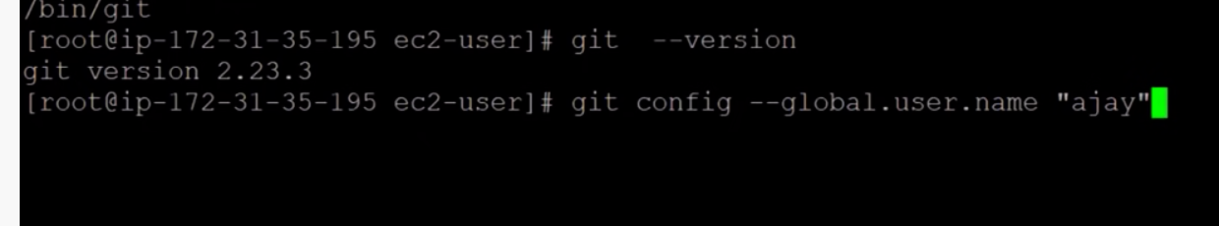
Check the version of git
Check next command git config

Slide 34
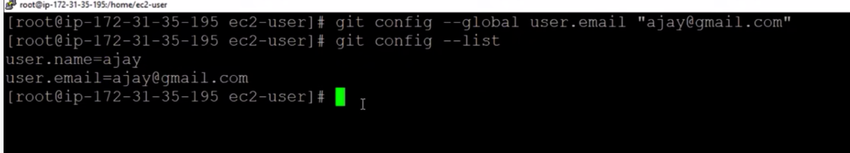
Add username along email and now check email and username

Slide 35
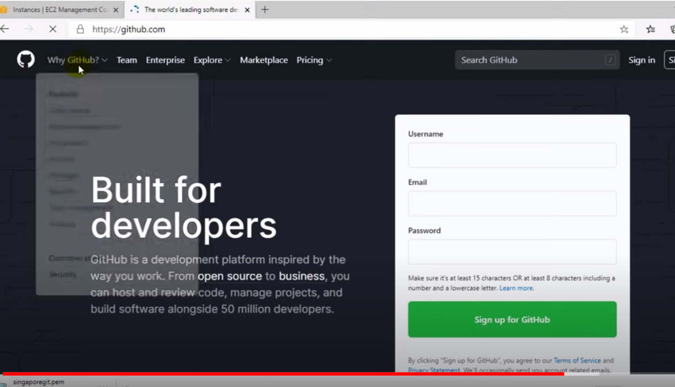
Open GITHUB
Create account

Slide 36
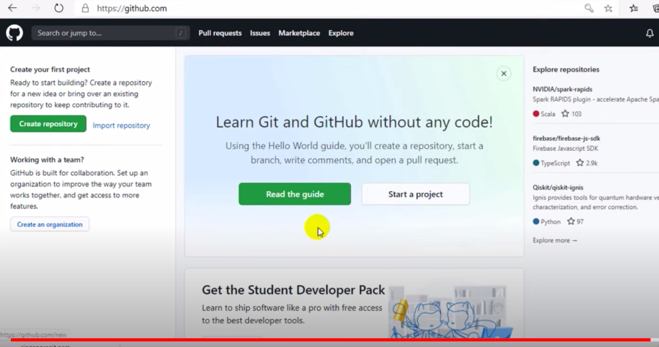

Slide 37
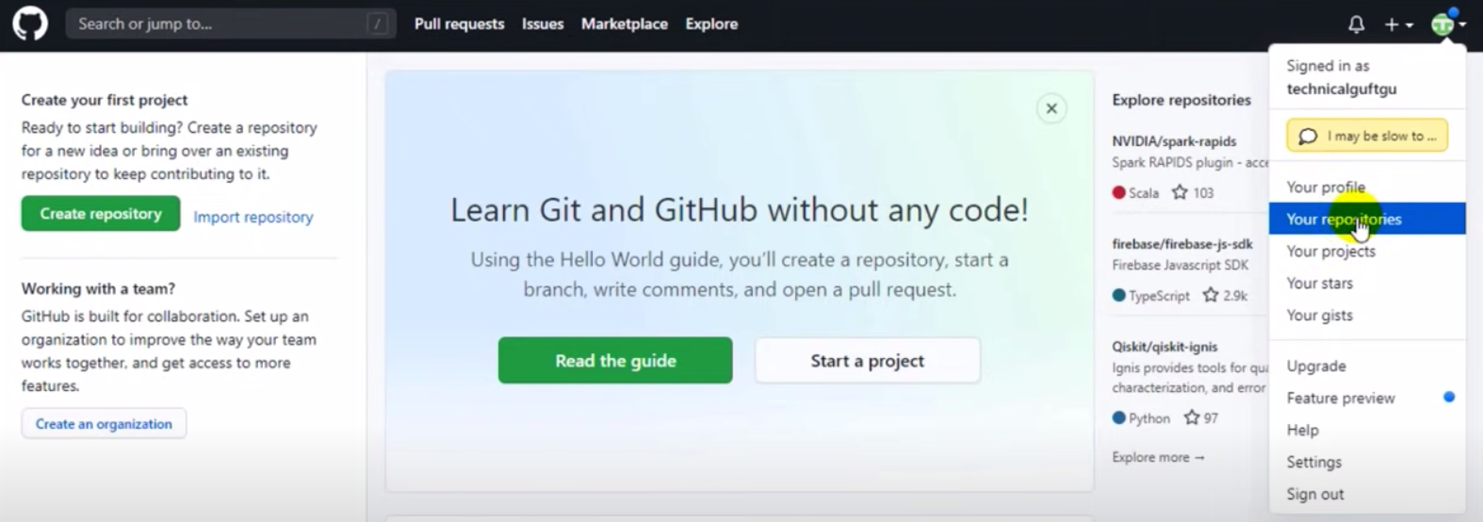
Check ur repositories here

Slide 38
Once done with this github setup, setup a machine for Singapore region
Now setup has been done

Slide 39
LOGIN into Mumbai EC2 instance:
Create on directory and go inside it
Git init
Touch myfile(put some data)
Git status
Git add
Git commit-m “ 1st commit”
git log
Git show < commit id>
Git remote add origin <central git url>
git push –u origin master (add username and password)

Slide 40
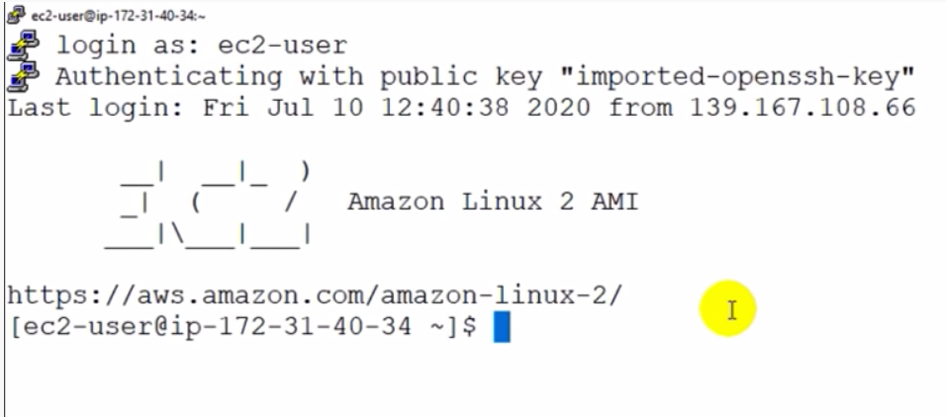
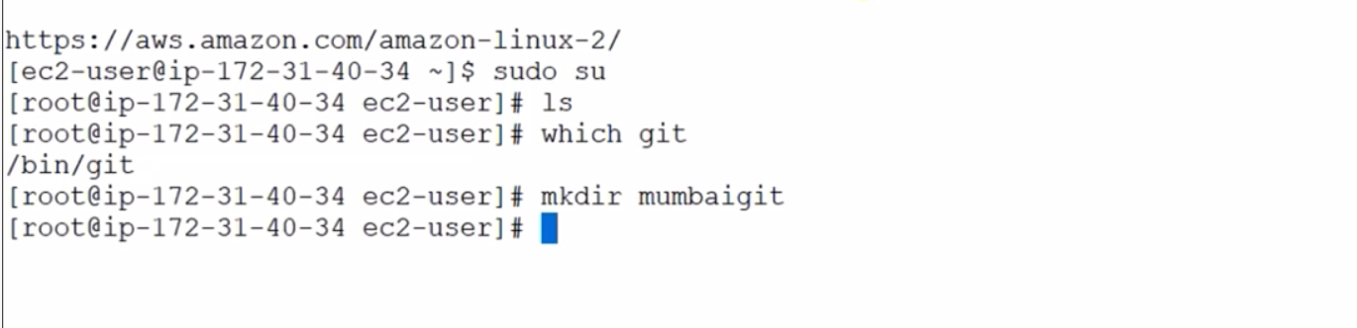
Enter as ec2 user
Make root user
As I have already installed git
Check it

Slide 41
Enter git init (make it git repo)
Hidden file by the name of .git
Enter text inside a file : cat > Mumbai 1
Then enter any text inside that

Slide 42
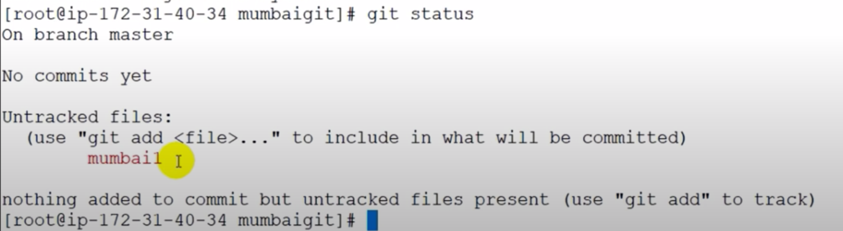
There is something inside the work space that has not been commited yet
Now this is untracked file? Because its not in staging area yet
So as to track the file before commit I need to add it to staging area

Slide 43
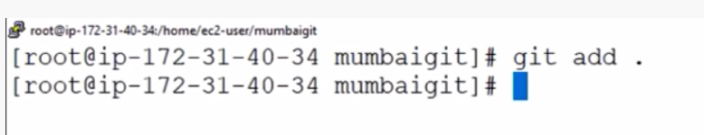
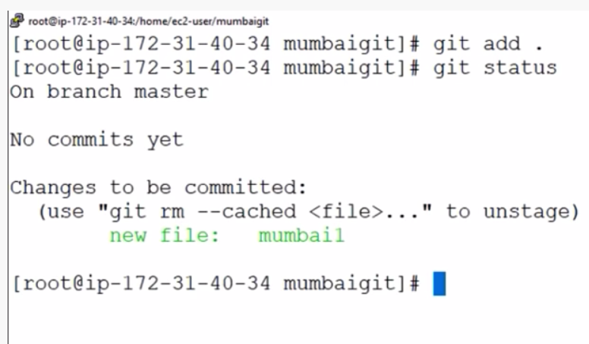
Add the file now using this command
Check Git status now:

Slide 44
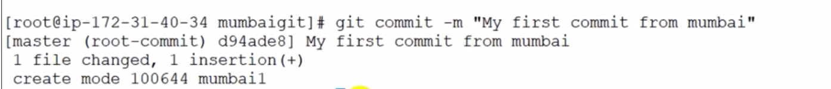
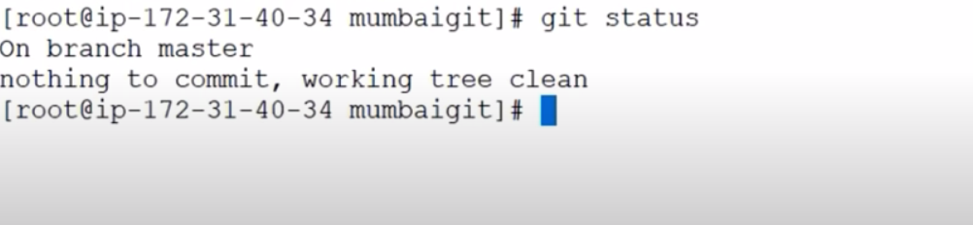
Now commit the file
Now if I check working status

Slide 45
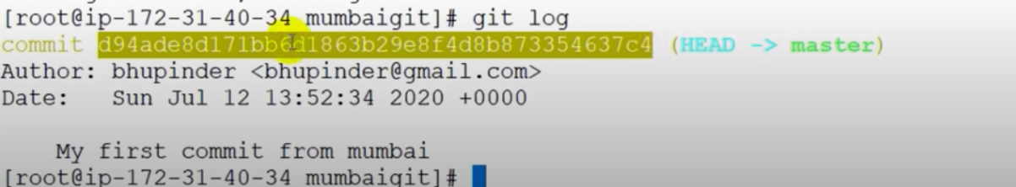
Check git log
Check the whole file using this command:

Slide 46
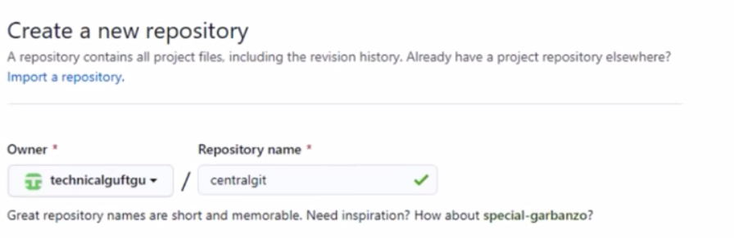
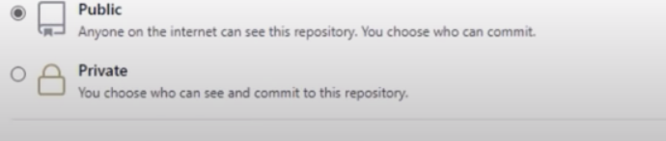
Open github, Sign-in there

Slide 47
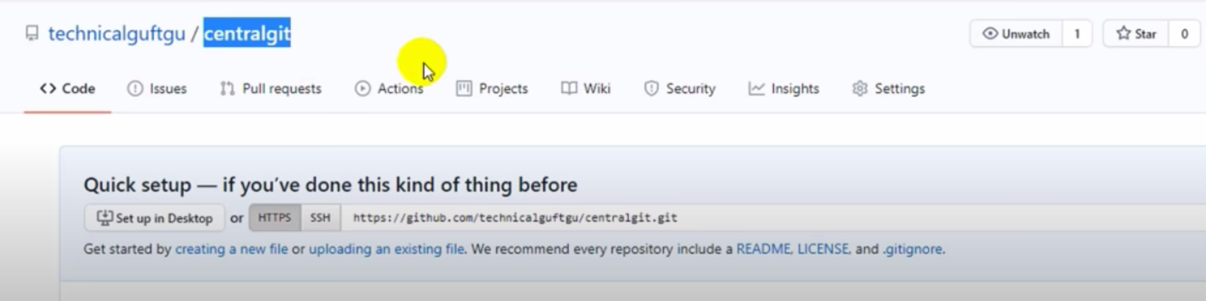
A central repo has been created by the name of central repo

Slide 48
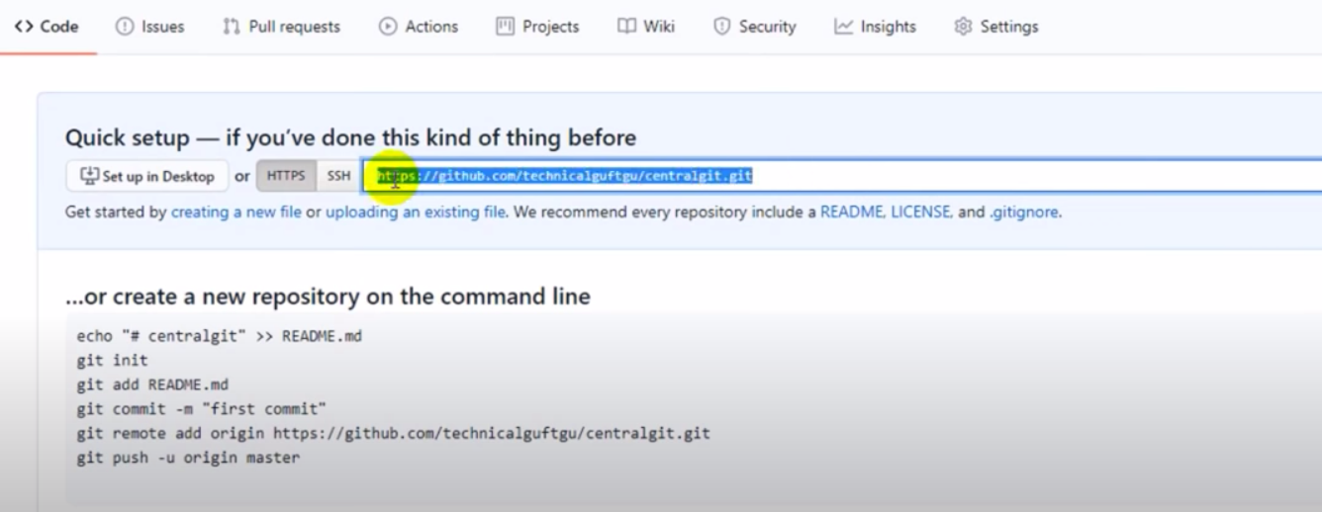
Just below it is the URL to reach this central repo through URL

Slide 49
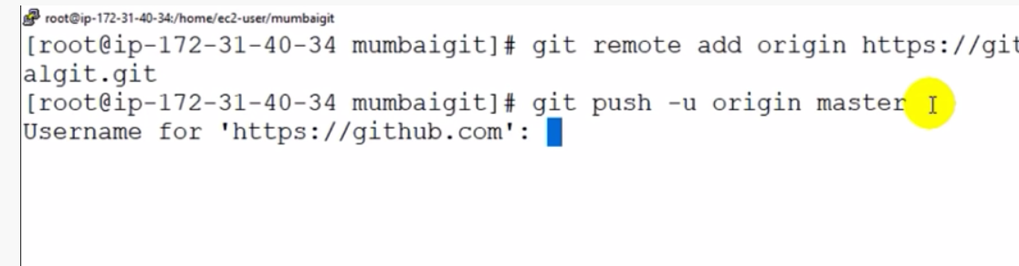
Copy that and move to putty
Push operation

Slide 50
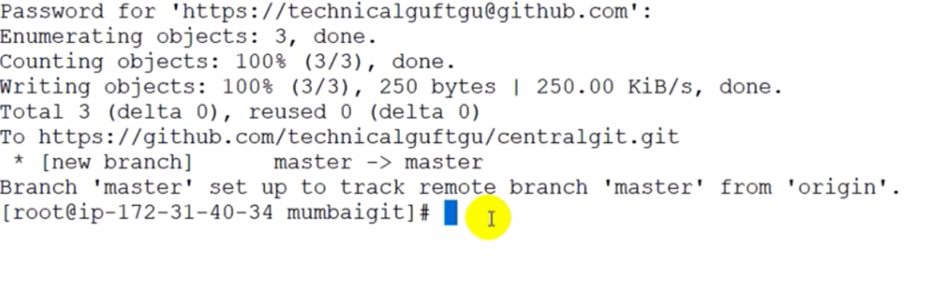
Push the data like this

Slide 51
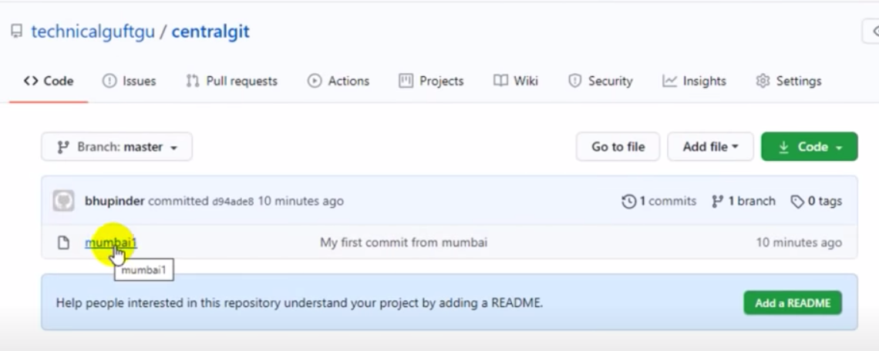
Check it on GITHUB

Slide 52
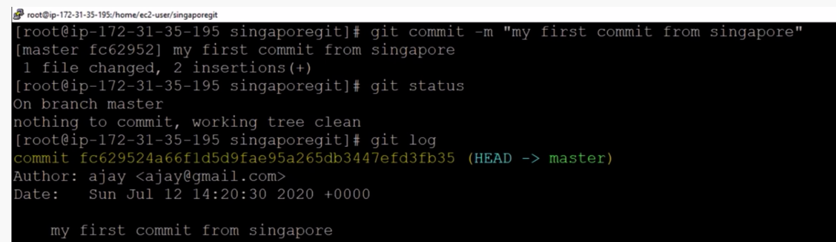
This is a file created at Singapore ec2 machine. Add it, push it to central repo

Slide 53
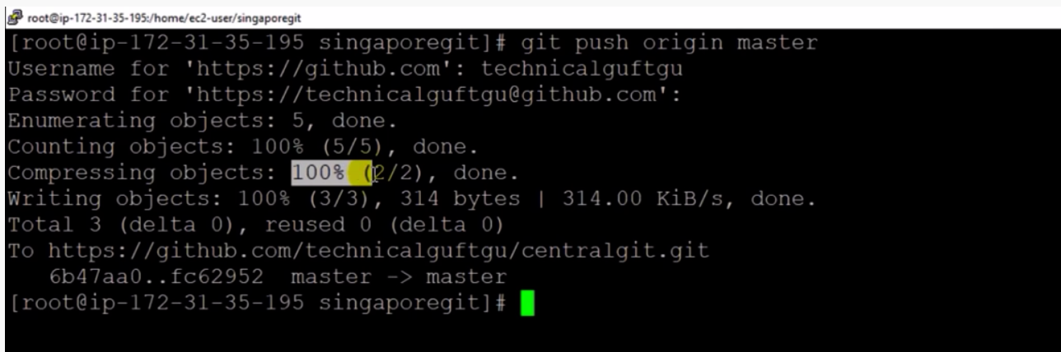
File pushed to central repository

Slide 54
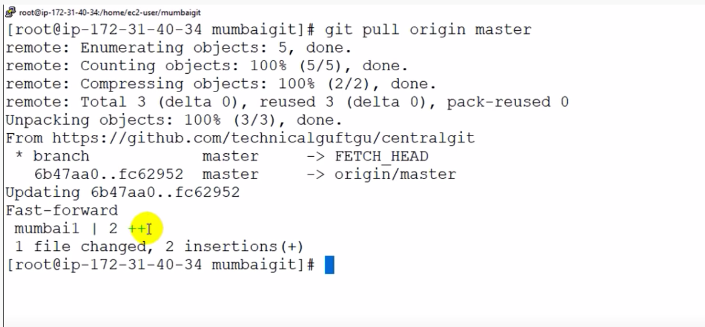
Pull the data from central repo to Mumbai machine

